Slide 1

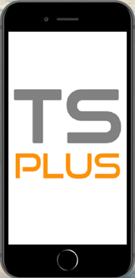

Securely Access Your Apps Everywhere!
TSplus® Presentation

Slide 2
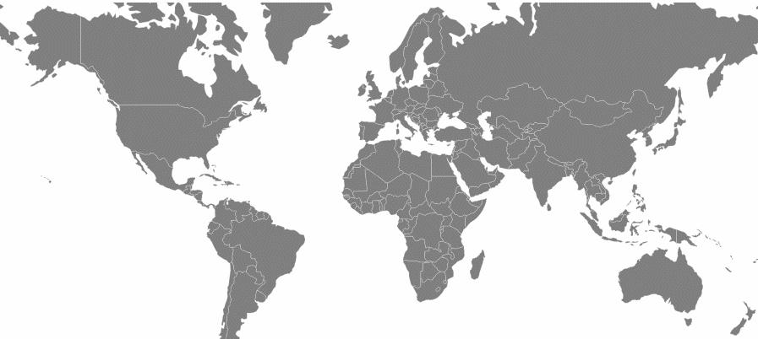
Who are We?
10 Years
10 Regions
5K Resellers
3M Users
Of experience in Remote Desktop solutions
Over the 5 Continents
One Distributor / Region
Selling TSplus online all over the World
100% Satisfied by TSplus and its Add-ons
Notes:
Who Are We? (Total Duration 0:50)
(Duration 0:30) TSplus is a global leader in remote access technology. From day one, our vision and our products have been built on the idea that the ability to work remotely and to collaborate across time zones and borders should be affordable and manageable enough that startups and small businesses can spend more time innovating and less time worrying about their IT infrastructure and overhead costs.
At the same time the technology needed to be scalable and secure, with advanced management and deployment tools allowing for efficient integration into an enterprise environment.
(Duration 0:20) With over 10 years of providing remote desktop solutions, TSplus is a field-proven technology in cloud computing. We support five thousand retailers and three million users in ten regions, spanning 5 continents. We’ve made it our mission to create robust solutions to keep your business connected.

Slide 3
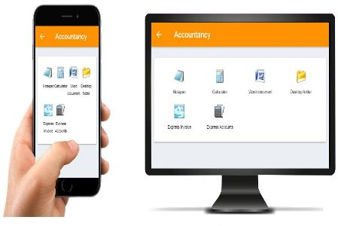
Connecting the World
ACCESS EVERYWHERE
From Smartphones & Tablets…
…To Workstations
Security - Scalability - Reliability
Performance and Productivity
Cost and Risk
Notes:
Connecting the world (Total Duration 0:53)
From Workstations To SmartPhones and Tablets
Device standardization has long been a part of maintaining network security and integrity. This has often meant ballooning tech budgets or cutting corners on client devices and software licenses for the sake of getting all the parts of your network to work well together.
TSplus offers cost-effective connection solutions, no matter what type of device you use. We have secure app and web-based solutions for Windows, iOS and Android, as well as web-based solutions for Mac users.
While a certain amount of internal standardization will always remain part of every good administrator’s best practices, TSplus gives administrators more flexibility in their deployment methods and target devices.
Whether your preference is classic Remote desktop on your notebook, published applications on your office workstation, or real time collaboration from a mobile device, TSplus has a solution for you.

Slide 4



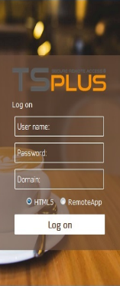
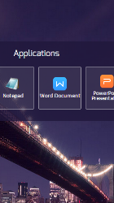
Cross-platform Connectivity
WITH HTML5 AND REMOTEAPP WEB CLIENTS
From Any Device
Secure Web Access
Latest HTML5 Technology
Easily Print and Transfer Files
Notes:
Cross-platform connectivity (Duration 0:20 seconds)
Thanks to our platform-agnostic HTML5 Web portal, TSplus ensures availability of your business applications on any modern device.
With Access to client/server file transfer and the TSplus Universal Printer, the TSplus web client is a great way to maintain workflow continuity for people that work on multiple platforms.

Slide 5
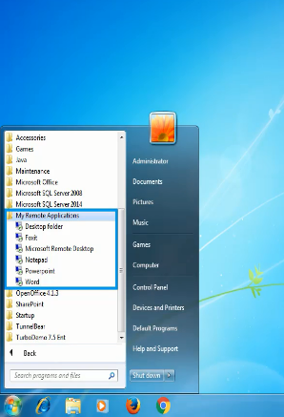
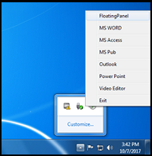
TSplus RemoteApp on Client
Launch Remote Applications as Integrated Programs
On the Start Menu
With a Systray Icon
Notes:
RemoteApp on client (Duration 0:35)
For windows users, we have even more options. We know workflow is important.
As traditions in how we work have evolved, TSplus has evolved with them.
The TSplus RemoteApp on Client feature moves beyond the traditional remote desktop and integrates your published applications into your local windows environment, appearing alongside locally installed applications and removing the distractions that can come with working in multiple environments simultaneously. This will improve productivity and cut down training time and costs when bringing new users onboard.

Slide 6
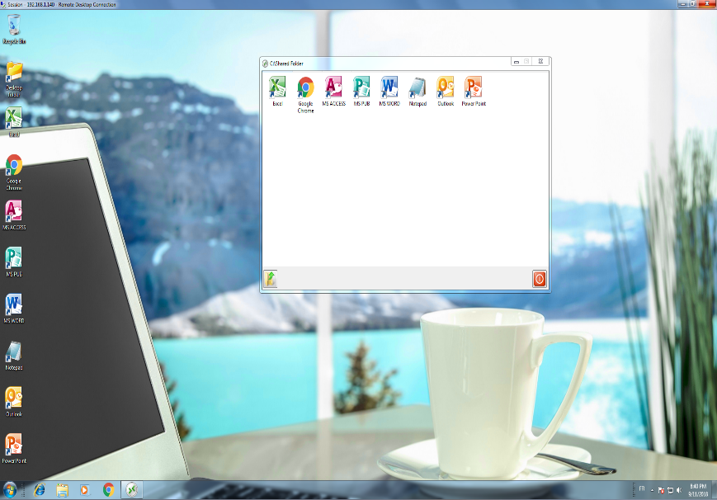
Generated client
Connect with Remote Desktop, RemoteApp or Seamless Clients
Notes:
Generated Client (Duration 0:20)
For those with increased access requirements, TSplus offers a secure generated client.
The generated client offers all the access and security of the web client, with the added benefit of increased display configuration options, hardware redirection and use with load balanced servers.

Slide 7
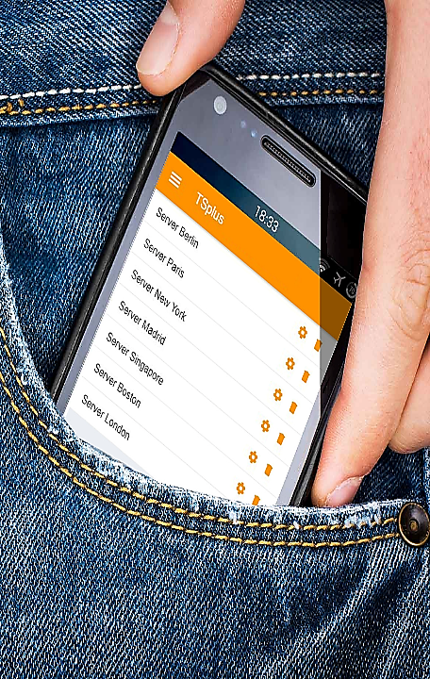
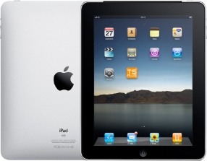




Be Mobile: Discover The TSplus APP
WORK WHEREVER YOU ARE, WHENEVER YOU WANT
Secure Mobile Remote Access
on ANY MOBILE DEVICE
Notes:
Mobile App (Duration 0:30)
Be Mobile – Discover the TSplus App
Work wherever you are, whenever you want –
With the TSplus Mobile App, your business applications are available anywhere in real time, all you need is an internet connection.
The Mobile App is available for Android and iOS. Just like TSplus software for Windows, the Mobile App offers fast and stable connections.
Its user-friendly and responsive interface is designed on the same principles of security, simplicity and scalability.

Slide 8
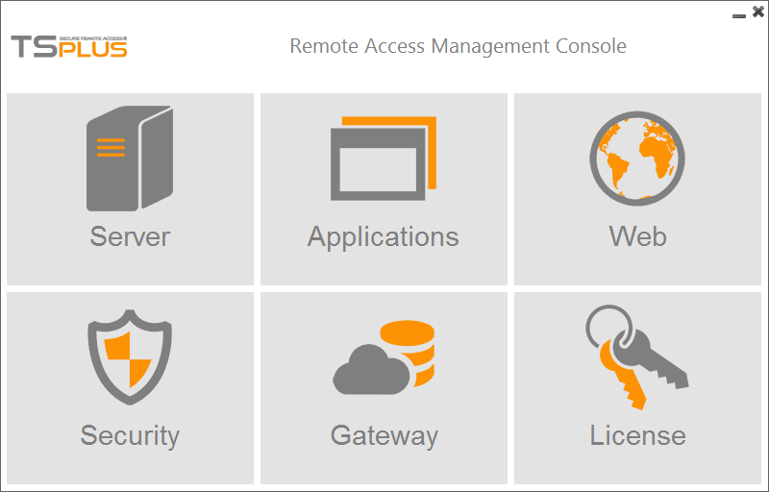
TSplus Administration Tool
ONE INTERFACE TO MANAGE ALL SERVERS SETTINGS
Easy and Central Management
Manage Users and Servers
Assign & Publish Applications
Customize remote sessions
Notes:
Server Administration of connections and client resources
Tsplus Administration Tool (Duration 0:25)
The Admin tool is the heart of TSplus. It is the command center where everything happens.
The Admin Tool offers full control of every aspect of TSplus, all while maintaining a simple interface and easy setup and management.
Here you can create new user accounts, publish applications, manage user groups and even customize your corporate web access portal!

Slide 9

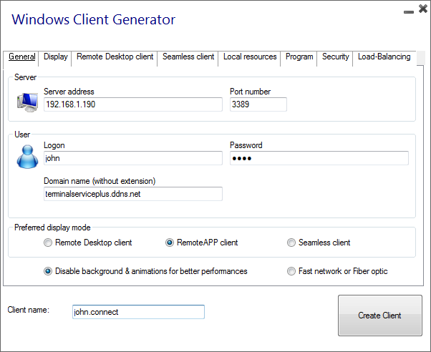

TSplus Client Generator
TURN ANY WINDOWS SYSTEM INTO A REMOTE DESKTOP
Available for:
Windows XP to Windows 10
Servers 2003 to 2016
Windows 32 and 64-bit
Notes:
Portable Client Generator (Duration 0:35)
The Portable client generator allows administrators to create a packaged, customized connection client. Generated clients can be pre-built by administrators to meet the specific needs of a single user or for large scale deployments across multiple work sites.
The Portable client generator can create the whole range of available TSplus connection configurations.
From a single published application, to the complete remote desktop experience.
With the Portable Client Generator, it only takes a few easy steps to create a connection client for TSplus.

Slide 10
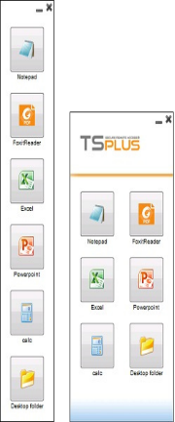
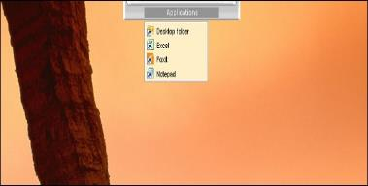
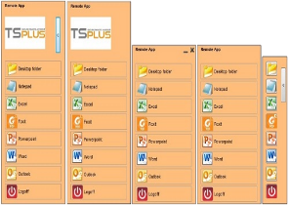

Publish and Assign Applications
BUILD YOUR UNIQUE USERS ENVIRONMENT
Floating Panel
Application Panel
Remote Taskbars & Desktop Themes
Notes:
Assign and Publish Applications (Duration 0:30)
Web-enable your business applications with TSplus application publishing. The setup is fast and easy.
Assign applications to users or groups.
Customize your user sessions with the TSplus Floating Panel, Application Panel and Remote Taskbar for a better display experience.
You can change the size, position and style at your convenience. You can even add your favorite background image!

Slide 11

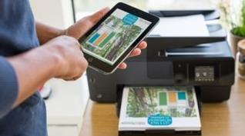

Print with TSplus Universal Printer
PRINT YOUR REMOTE FILES ANYWHERE
No driver needed!!!
Print locally in any format
Connect with any device
Notes:
Print With the TSplus Universal Printer (0:30)
The TSplus Universal printer works with all types of TSplus connection clients. No client-side drivers or special configuration is required. No more stuck spooler process, just smooth, easy printing from your remote session to your local printer.
With the Universal Printer Manager, you can install, uninstall, and check the status of the printer. Here you can also configure the default behavior of the Universal printer on a per user or per group basis.

Slide 12
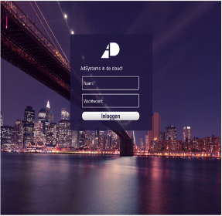
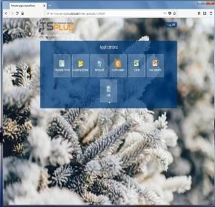
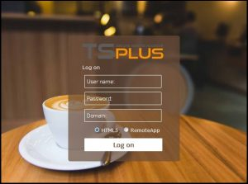
Build Your Web Application Portal
DESIGN A CORPORATE ENVIRONMENT FOR YOUR USERS
Add your
Company Logo
Select the
Color Theme
Change the Background Image
Notes:
Server administration - Backend (management of infrastructure, access, security and add-ons) : Build Your Application Web Portal (0:30)
There’s no need to be a Web Developer to customize your Corporate Remote Web Access page.
With the AdminTool, you can easily manage all the graphic settings and design in one place. Design a Web Portal that reflects your business and respects your corporate image!
Secure your web server with an SSL certificate. With TSplus you can generate your own self-signed SSL certificate in minutes, or you can integrate an SSL issued by a third-party certificate authority.

Slide 13

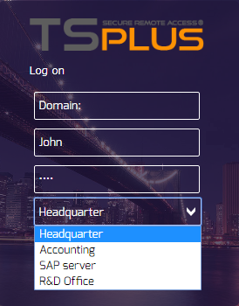
Install TSplus on Multiple Servers
Manage all your Servers thanks to
TSplus Enterprise Integrated Features
Notes:
Install TSplus on Multiple Servers (0:28)
TSplus was designed with scalability in mind. The Enterprise Edition integrated feature set helps you easily manage your connection load and data access across multiple servers.
TSplus enterprise edition includes the TSplus Farm Manager and Gateway portal. These features give administrators the tools they need to centrally manage your server farm, including traffic management and load balancing.

Slide 14

Keep your Connections Safe
EASILY SECURE YOUR TSPLUS SERVER
WEB CREDENTIALS
HTTPS PROTOCOL
FREE SSL CERTIFICATE
Control Users Access
Block Failed Login Attempts
Secure Serveur Connections
Protect Business Data
Notes:
TSplus offers a set of simple and effective ways to enforce good levels of security.
The Administrator can set numerous server access restrictions, end-to-end encryption for logon/password and HTTPS protocol.
With TSplus you can generate your own self-signed SSL certificate in minutes, or you can integrate an SSL issued by a third-party certificate authority.

Slide 15

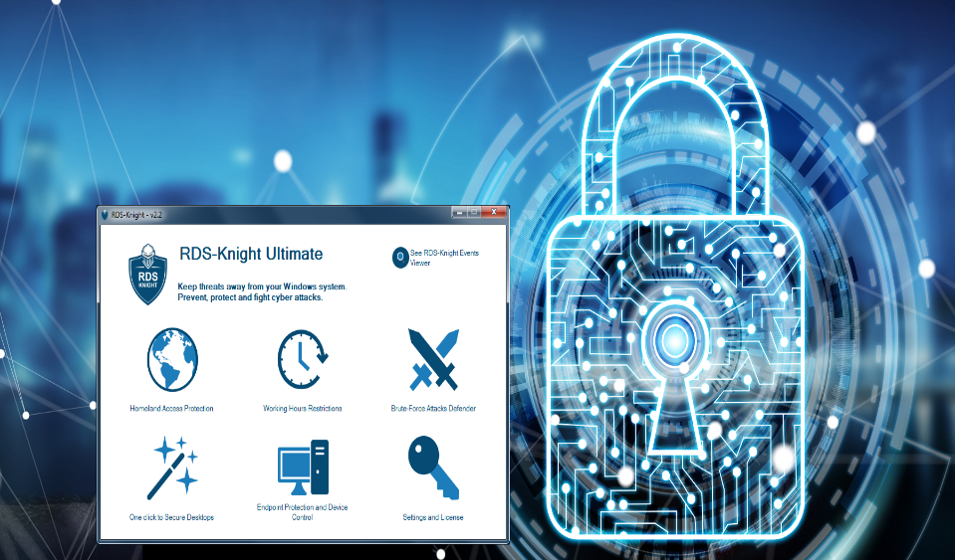
Enhance TSplus Security with Add-Ons
RDS-Knight
THE PERFECT ALLY TO SECURE YOUR SERVERS
Notes:
Enhance TSplus with Add-ons – RDS-Knight (Duration 1:05)
RDS-Knight is the security tool every administrator must have to protect their servers from cyber threats. TSplus embeds a trial version that is installed automatically if the user approves it.
This TSplus Add-On provides 5 exclusive features:
- Geo-Protection for RDP - This lets administrators allow connections only from approved countries
- With Work Hours Access Restrictions, you can enforce logon schedules, limiting access by user or group, to only the hours necessary for work.
- Brute Force Attack Protection monitors failed logon attempts and automatically blocks further connection attempts from suspicious sources after the failure threshold is reached
- Secure level User Access – Not every user needs unlimited access, limit user access to anything from a specific application to the Windows control panel.
- Endpoint Protection stops access from unauthorized devices. With Endpoint protection you can bind a user account to one or more device names. Should a user attempt to login using an unauthorized device, Endpoint Protection will automatically block the attempt.

Slide 16

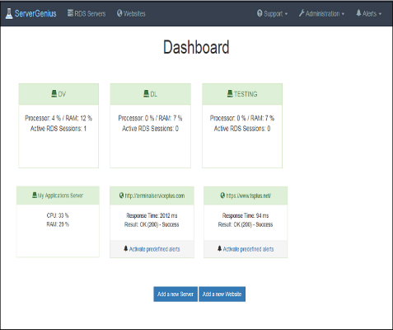
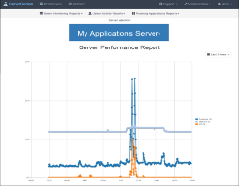
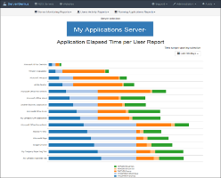
Enhance TSplus Security with Add-Ons
Server Genius
MONITOR YOUR SERVERS AND WEBSITES HEALTH IN REAL-TIME
Notes:
Enhance TSplus with Add-ons - Server Genius (Duration 0:35)
Server Genius Simplifies Network Monitoring.
Monitor your server and website health in real time with server genius.
From its simple setup to its advanced monitoring capabilities, Server Genius monitors hardware performance, remote connections and web traffic. Administrators can check the status of operations at a glance.
Server Genius lets you track usage trends with simple reporting. This is a great tool for gaining insight into when and how users are accessing your Business Applications.
It also has a notification feature which facilitates faster response times on those rare occasions when something does go wrong.

Slide 17


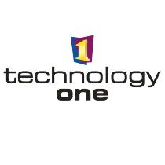






Join the TSplus Community
They Trust TSplus
Notes:
- Siemens Health care
Siemens is using TSplus to help radiologists.
The Siemens equipment to create medial pictures are locally stored.
TSplus enable to share access to these picture for:
- The medical assistants (who has to print it)
- Any other doctor in the hospital requiring to look at it
- The radiologist himself who can review them in is office
...
The Health care sector is one of TSplus market segment. Thousands of hospitals/Medical centers are using TSplus
- The Red Cross
The German Red Cross Emergency Call Center is using TSplus to share the application, the data and to print
- Handicap International
The worldwide headquarter of Handicap International is using TSplus for years.
- Spa Salon
Thousands of SPA salons in the US are using Amazon Cloud hosted application to handle their agenda, billing, accountancy...
One of the raison why the editor decided to use TSplus is obvious: none of these tens of thousands users are skilled in IT
- Honeywell
Honeywell is one of the world wide leading company in the sector of Building IT.
They decided to integrate TSplus within their Building Security solutions.
- Texas Instrument
TI has deploy TSplus in all of its plants to handle the production process (MRP).
- UCLA, Harward, Paris La Sorbonne and hundreds of University/Colleges are using TSplus for academic purposes
- TechnologyOne is the largest Australia Cloud hosting company and they are offering TSplus for years to their customers.
- Clarion developers: Clarion is a 4GL widely used to develop mission critical applications. The Clarion developer community decided to use TSplus to web enable their Clarion applications.
- Auchan
Auchan is one of the worldwide large chain of medium and large shopping malls.
In Europe they deployed TSplus within their 1.800 restaurants.

Slide 18
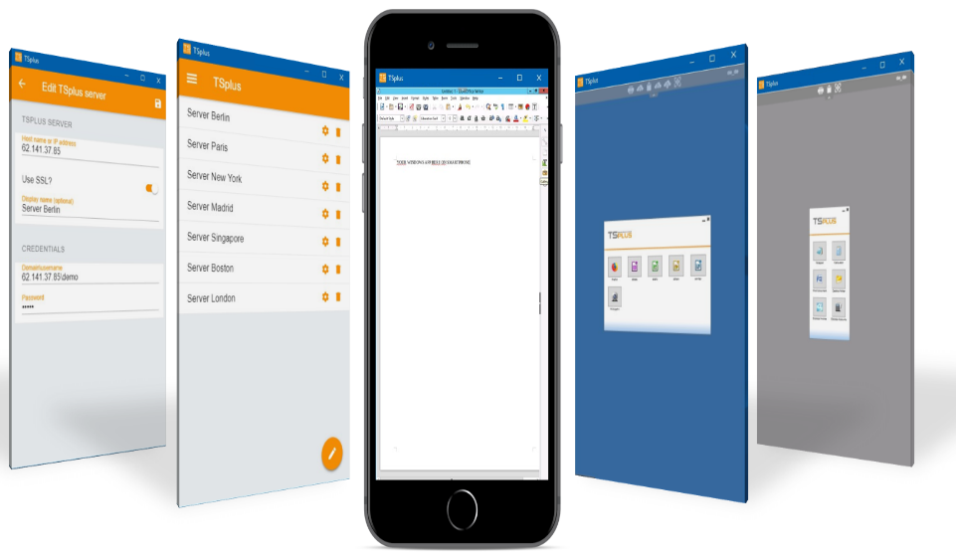
The Future is Now! Are you ready?
Welcome TSplus as the New Partner of your Success
Notes:
The future is now (Duration 0:30)
From our core software to our suite of add-ons, from the simple administration tool to the Server genius advanced monitoring system, TSplus is the best solution for offering robust, high availability for your Business Applications, no matter the size of your business.
Your data IS your business.
It’s time to take the next step and welcome TSplus as the new partner in your success story. (END)

Slide 19


Q & A
Welcome TSplus as the New Partner of your Success

