Slide 1

AppScaler 101

Slide 2
About AppScaler
What AppScaler Do
AppScaler Difference
Benefits
Applications High Availability
All-in-One Application Delivery
Unmatched Scalability
Simplicity
Accelerate Application Delivery
Application Visibility
Optimized Application Availability
64 Virtual Instances on one unit
Layer 3 -7 Security Protection
Dual IPv4 and IPv6 Stack
Robust Application Security
Single Sign On
High Quality User Experience
Full APIs
Cost Effective Application Delivery
High Performance Platform

Slide 3
About AppScaler
XPoint Network (Hong Kong) was established in 2015 to provide a flexible and cost-effective turn-key application delivery solution.
The team at XPoint Network is equipped with a highly developed skillset developed over decades of experience in rigorous, unforgiving ISP environments, and this business experience makes us uniquely positioned to offer application delivery solutions promising stability, scalability and top notch performance.

Slide 4











Customers

Slide 5
AppScaler 101
Server Load Balancing (SLB)
Global Server Load Balancing (GSLB)
Application Security
Application Optimization
Multi-Tenancy
Product Offerings

Slide 6
Server Load Balancing
AppScaler 101

Slide 7
SLB – Load Balancing
Health Monitor Check
Content Switching
Persistence
Load Balancing
Deployment Mode
Check RS Health Status
Layer 7 Payload
Store Session Info.
Layer 4 – 7 TCP/UDP
Deployment Options
Ping Host
TCP Echo
Telnet
RDP
HTTP(s) 1.0/1.1/2.0
DNS
FTP
SMTP
POP3
IMAP
NNTP
LDAP
URL
URL Tokens
HTTP Method
HTTP Request
HTTP Header
Source IP
HTTP Content
HTTP Cookie
Application Cookie
Cookie Hash
URL Hash
Query Hash
Custom HTTP Header
Source IP Hash
SSL Session ID
UDP SIP
RDP Service
RDP Session
RDP Source
Round Robin
Ratio Round Robin
Least Connection
Ratio Least Connection
Predictive
Ratio Response Time
Source IP Hash
One armed
Multiple armed
NAT
Direct Return
Reverse Proxy
VLAN/XVLAN/Port Bond
IPv4/IPv6 Dual Stack
Notes:
When user requests reach AppScaler, policies executed in the following order:
Health check on Real Server status, if real servers are down, request rejected or redirected to pre-defined HTTP redirection page
If the content switching policy in place, the user request will be distributed to the real server based on content rule
If the persistence policy used, the same user request will be routed to the same real server
Load balancing policy will be used

Slide 8
SLB – Health Monitor Check (Overview)
Each virtual service has a monitor bound to it. And AppScaler probes the real server health status via monitor.
If real server responds to the probe, the monitor marks it UP
If real server fails to respond to the monitor within the pre-defined time period for the number of pre-defined times, the monitor marks it DOWN. And AppScaler will remove the real server from the server pool hence it will not receive the user requests.

Slide 9
SLB – Multiple Health Monitors
VS Group/VS Members designed to configure multiple health monitor for one VS.
VS Group
VS Members
Health Monitors
The nested VS which holds multiple VS members.
Each VS member can have its own health monitor.
VS Member 1
Health Monitor 1
VS Member 2
Health Monitor 2
VS Member 3
Health Monitor 3
VS Member N
Health Monitor N

Slide 10
SLB – Content Switching (Overview)
Distribute client requests to servers based on layer 7 payload including:
URL/URL Tokens
HTTP Method/Request/Header/Content
Source IP
Some User Cases:
Same VIP for different domains
Mobile/Desktop requests distributed to different servers
Direct request based on browser language
Route the traffic based on customer’s source IP to different servers
Route the traffic to specific servers based on URL pattern matching

Slide 11
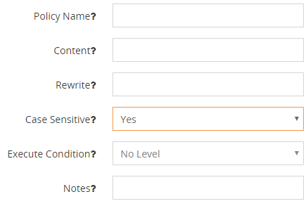
SLB – Content Switching (Response Rule)
Response Rewriting
HTTP Response content can be replaced with the pattern you specify.

Slide 12
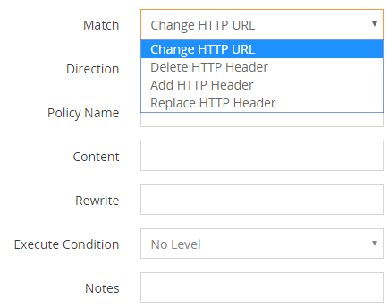
SLB – Content Switching (Header Rule)
Header Rewriting, both inbound and outbound http header can be modified including:
Change HTTP URL
Delete HTTP Header
Add HTTP Header
Replace HTTP Header

Slide 13
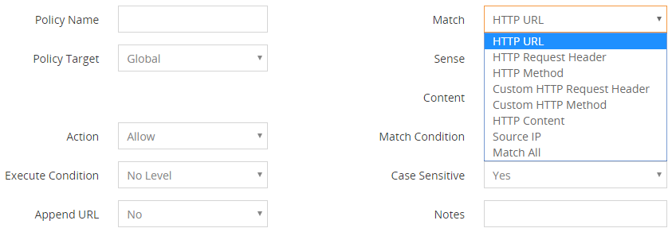
SLB – Content Switching (Content Rule)
Content rule can either be global or real server specific based on various attributes including: HTTP URL,HTTP Request Header, HTTP Method, Custom HTTP Request Header, Custom HTTP Method, HTTP Content, Source IP

Slide 14


SLB – Persistence
Clients are sent to the same real server until the persistent connection expires.
Users
Persistence
Real Servers

Slide 15
SLB – Load Balancing
AppScaler supports various load balancing methods, either static or dynamic.
Users
Load balancing
Real Servers
Notes:
Static load balancing methods will NOT consider server performance and it will distribute the user requests among real servers.
Round Robin
Ratio Round Robin
Predictive
Source IP Hash
Dynamic load balancing methods will take server performance into consideration.
Least Connection
Ratio Least Connection
Ratio Response Time

Slide 16


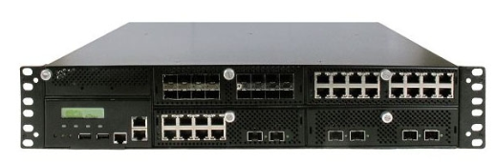
SLB – Dual IPv4 and IPv6 Stack
Full support on Dual IPv4 and IPv6 Stack
Automatic IPv4/IPv6 conversion makes IPv6 migration much easier
Client(IPv4)->VS(IPv4)->RS(IPv4)
Client(IPv6)->VS(IPv6)->RS(IPv6)
Client(IPv4)->VS(IPv4)->RS(IPv6)
Client(IPv6)->VS(IPv6)->RS(IPv4)
Response rewrite to fix external links in IPv4 website
IPv4 and IPv6
Auto Conversion
Real Server
IPv4 or IPv6
Virtual Server
IPv4 or IPv6

Slide 17
Global Server Load Balancing
AppScaler 101

Slide 18
GSLB - Overview
Global Server Load Balancing (GSLB) makes your network reliable and available by scaling applications across multiple data centers for disaster recovery or to improve application response times.
AppScaler provides flexible, scalable and high-performance load balancing across geographically dispersed datacenters to provide protection against the effects of business continuity and disaster recovery events. Working as authoritative DNS for the desired domain, it can support a wide range of load balancing algorithms to direct DNS queries across optimal paths to servers at highly-available datacenters.
AppScaler can be configured across multi datacenters to exchange datacenter metrics, network metrics, real server metrics and persistence information as one cluster.

Slide 19
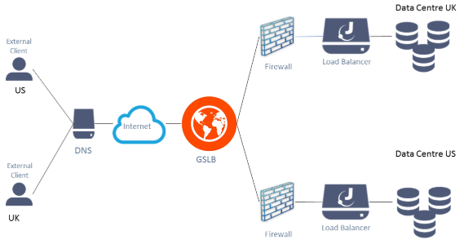
GSLB - How it works
AppScaler acts as authoritative domain name server (ADNS) to resolve Web site domain and sub-domain names. All DNS requests will be processed and responded by AppScaler which will select best site and the most suitable GSLB virtual service IP address to the client.
Data center failover and continuity
Client geographic awareness
Distributed site performance awareness
Best performing sites get fair proportion of traffic

Slide 20
GSLB - DNS Integration
AppScaler can act as authoritative name server for an entire zone or subdomain, by adding one NS record pointing to XPoint AppScaler IP address, it is all set. The A (IPv4) and AAAA (IPv6) are supported.
The process of domain name resolution provided by AppScaler is as below:
The client sends DNS query to local DNS to resolve the domain www.test.com
The local DNS finds that AppScaler is the authoritative DNS for domain www.test.com
Local DNS forwards the DNS query to AppScaler
AppScaler will determine which virtual service IP address is to returned based on its health and algorithm
AppScaler return the suitable virtual service IP address to local DNS server
The local DNS returns the virtual service IP address to the client

Slide 21
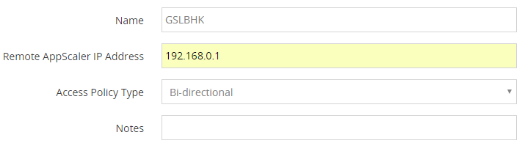
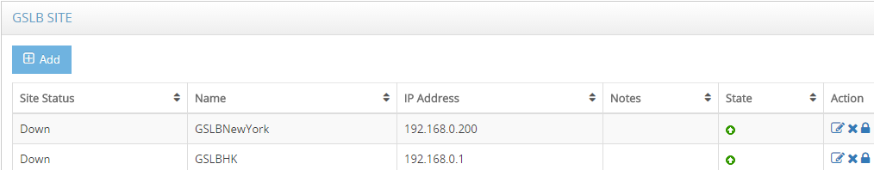
GSLB - Deployment Options
Outside the datacenters as authoritative name server in one single unit or HA pairs.
Deployed in each datacenter, either one single unit in each datacenter or HA pairs, all the AppScaler configuration is synchronized in real time and all the datacenter performance metrics are exchanged in real time

Slide 22
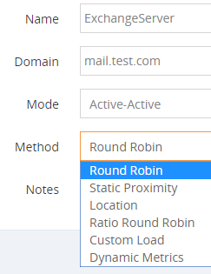
GSLB – Load Balancing Methods
AppScaler supports a wide range of global load balancing methods to provide highly flexible traffic distribution across multiple datacenters:
Active-Passive and Active-Active
Round Robin
Static Proximity
Location
Ratio Round Robin
Custom Loads
Dynamic Metrics

Slide 23
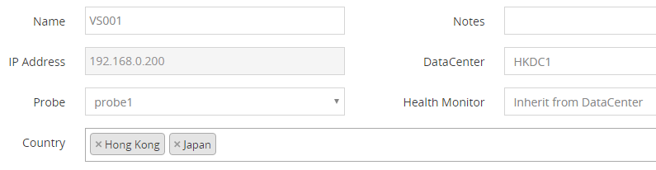
GSLB – Locations
With built-in location ip database, AppScaler can direct the client connections to the closest datacenters.

Slide 24
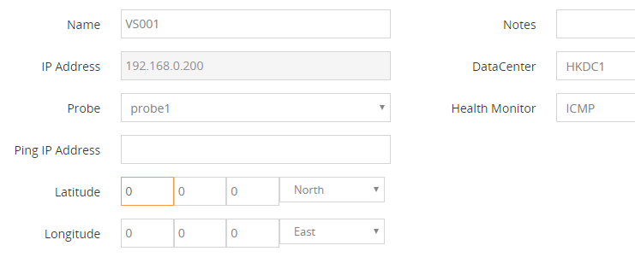
GSLB – Static Proximity
AppScaler supports custom proximity method which can direct client connections based on their location qualifiers.

Slide 25
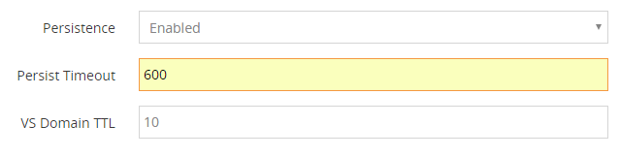
GSLB – Persistence
AppScaler supports GSLB persistence, a series of client DNS queries is sent to the same datacenter instead of being distributed based on load balancing methods.

Slide 26
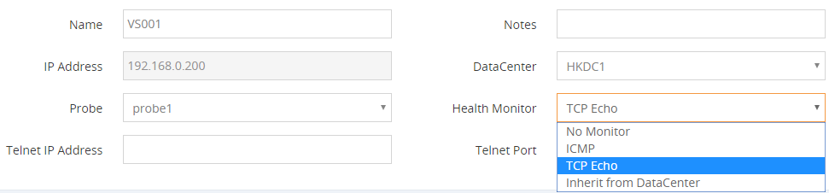
GSLB – Health Monitoring
AppScaler layer 3/4/7 health monitoring against virtual services in different datacenters:
ICMP
TCP Echo
Inherit the probe of datacenters
The integrated health monitor from Server Load Balancing

Slide 27
Application Security
AppScaler 101

Slide 28
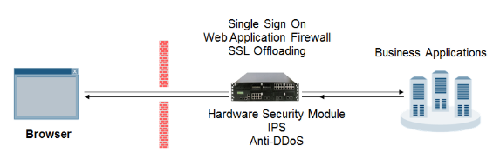
Application Security - Overview
AppScaler offers integrated security modules to mitigate the emerging threats at network, application layers.
Our unique approach to application security focuses on bringing best-in-class, easy-to-deployment and multi-layered protection to any business applications in either on-premise data centers or cloud.

Slide 29
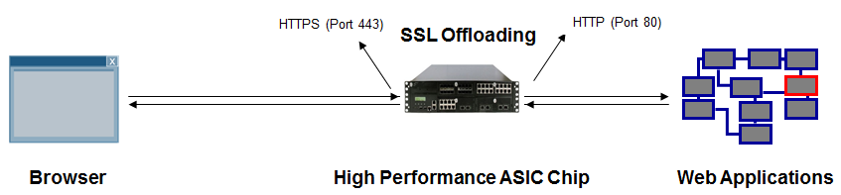
Application Security – SSL Offloading
ASIC SSL Acceleration Card: 75K SSL TPS
4096bit Key Support
SSL Visibility
SSL Termination and SSL Bridging Supported
TLS 1.0/1.1/1.2/1.3 and SSL 2.0/3.0 Supported
Central Certificate Management
Client Certificate Verification Support
OSCP Stapling Support

Slide 30
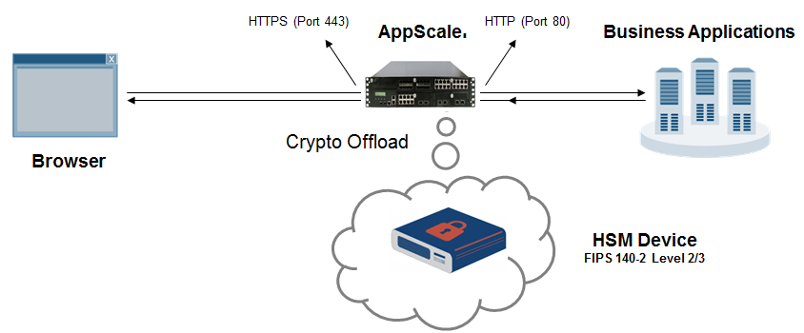
Application Security – HSM (Hardware Security Module)
A hardware security module (HSM) is a dedicated crypto processor that is specifically designed for the protection of the crypto key lifecycle.
AppScaler has the support for Safenet external hardware security modules (HSM). The Safenet HSM is FIPS-compliant and can be used to store private keys for AppScaler hardware or virtual appliance.

Slide 31
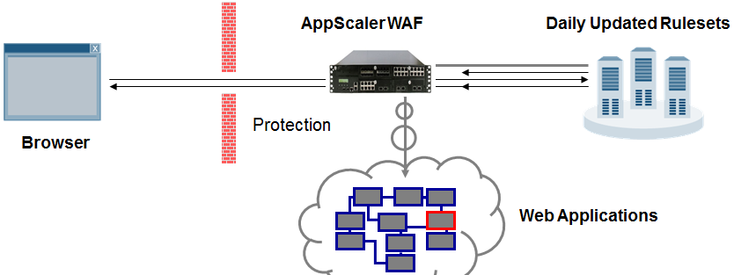
Application Security – Web Application Firewall
Full Coverage of OWASP Top-10 including XSS, Injection and CSRF
Protection against Zero-Day Web Attacks
Thousands of captured webshells and backdoors from web honeypot attacks can be identified and blocked
Identify and cut off web attacks generated by botnet clients
Detect and deny traffic originating from application-level denial of service tools such as HOIC/LOIC, Pandora, Drive, and more
Protection against sensitive data exposure and built-In IP Reputation Service

Slide 32
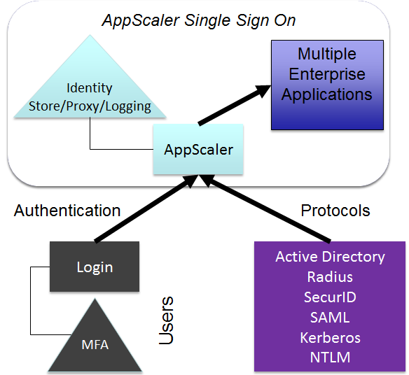
Application Security – Single Sign On
AppScaler provides centralized and flexible application access authentication to consolidate identity access management infrastructure and realize enhanced security at a reduced operational cost.
Unified Access Policy across different business applications
Pre-Authentication
Active Directory/SAML/Radius/RSA SecurID/NTLM Seamless Integration
Customizable Login Form
Dual Factor Authentication
Fully Programmed Post Form

Slide 33
Application Optimization
AppScaler 101

Slide 34
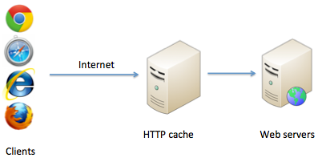
Application Optimization – Web Caching
Local storage of network data for re-use

Slide 35
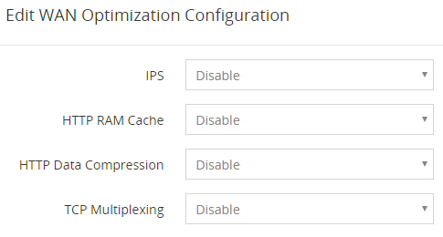
Application Optimization – Compression
Compress both static and dynamically generated data
GZIP or the DEFLATE compression algorithm

Slide 36
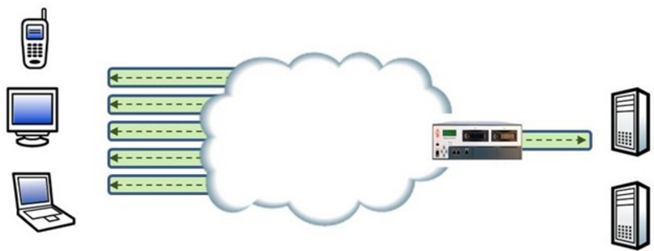
Application Optimization – TCP Multiplexing
Reuse existing TCP connections
Improve performance
Improve capability of servers

Slide 37
Multi-Tenancy
AppScaler 101

Slide 38


Multi-Tenancy - Overview
AppScaler VNF Manager allows customers to deploy AppScaler Application Delivery Controller as Virtual Function through single-pane-of-management platform. Regardless of where each AppScaler Application Delivery Controller is deployed, all load balancing functions are provisioned and managed centrally, AppScaler VNF Manager makes it possible to seamlessly design feature rich managed load balancing services with agility and capacity on-demand.
SSL
Tenant 1
AppScaler
Virtual
Appliance
Tenant 2
AppScaler
Virtual
Appliance
Tenant 3
AppScaler
Virtual
Appliance
Tenant N
AppScaler
Virtual
Appliance
Client
Server
AppScaler Hypervisor Platform
High Performance AppScaler VNF Hardware
Web Console

Slide 39
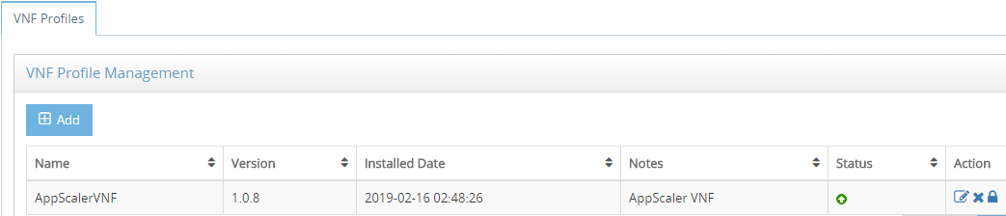
Multi-Tenancy - Zero-Touch Provisioning
VNF Manager reduces deployment time and minimizes time required for change management..
Profile based VNF Deployment in one click
ADC Tenant On-the-Fly Specification Configuration
Add/Start/Stop/Delete ADC Virtual Function
Template-based Tenant Resource Group

Slide 40
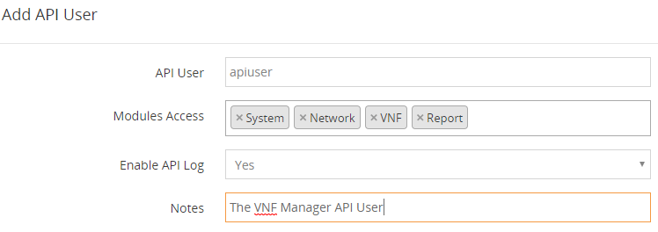
Multi-Tenancy - Programmability and Automation
VNF Manager provides comprehensive set of API for service provisioning and automation.

Slide 41
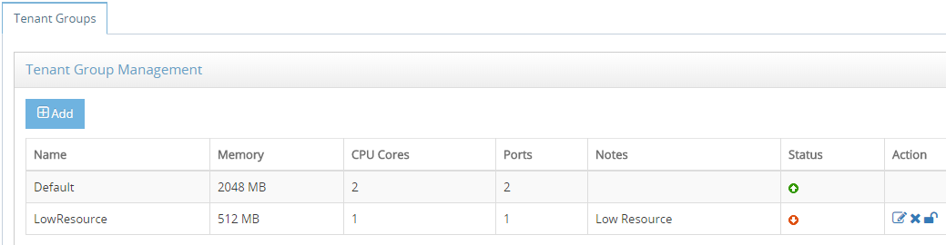
Multi-Tenancy - Scalability and Elasticity
VNF Manager allows customers to dynamically scale up and down based on capacity and performance requirements.

Slide 42
Product Offerings
AppScaler 101

Slide 43
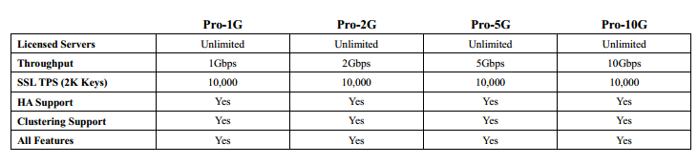
Product Offerings – Virtual Appliances
Runs on all the leading virtualization platforms and brings with it application-control capabilities, such as load balancing, increased security, optimized application delivery and failover support - all without proprietary hardware.
Available on ESXi, Microsoft Hyper-V, Oracle VirtualBox and KVM
Up to 10Gbps layer 7 throughput

Slide 44
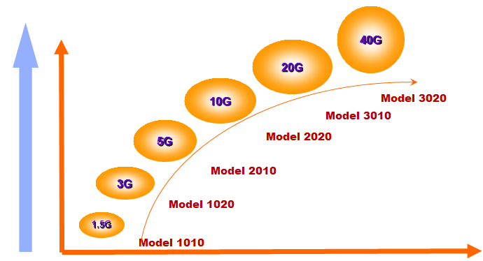
Product Offerings – AppScaler Appliances
Super computing platform
ASIC Chip SSL Acceleration Card
High Performance DPDK Optimized Kernel
Up to 40Gbps layer 7 throughput

Slide 45

Product Offerings – VNF Manager Hardware Appliances
VNF Manager allows customers to deploy ADC as Virtual Function through single-pane-of-management platform. VNF Manager makes it possible to seamlessly design feature rich managed load balancing services with agility and capacity on-demand.

