Slide 1
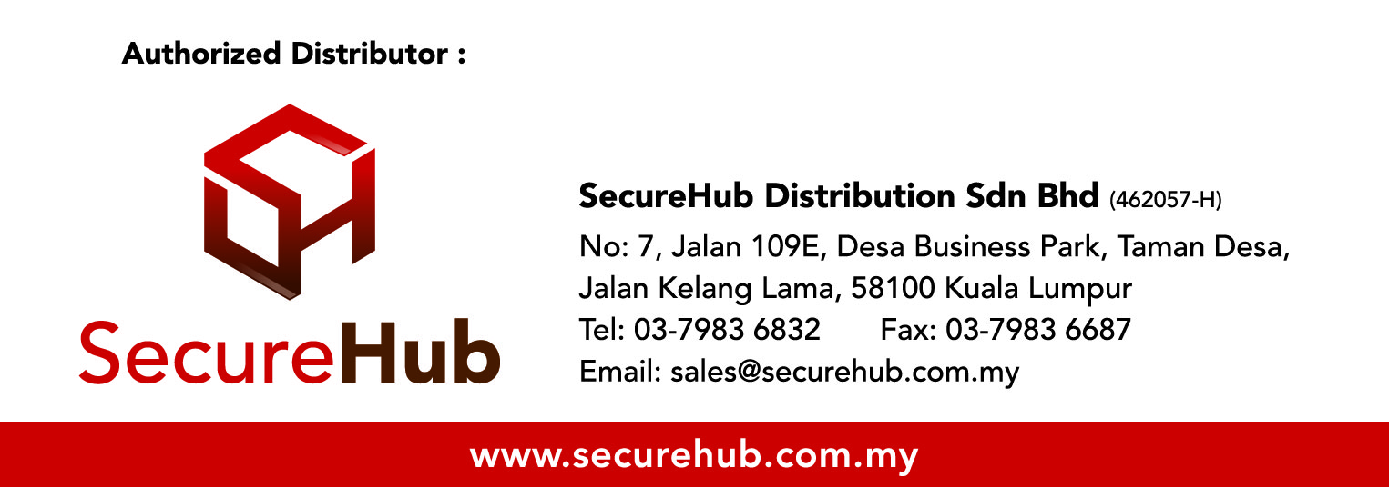
AppScaler Application Delivery Solutions

Slide 2
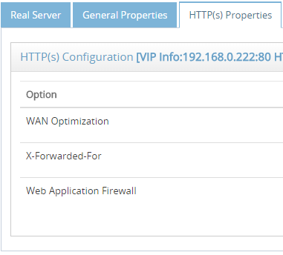
What does AppScaler do
  AppScaler manages your applications, so you can manage your business.
  Guaranteed Zero Downtime for mission-critical business applications
  Application Optimization with purpose-built technologies
  Meet security compliance

Slide 3
AppScaler Advantages
  High performance Software and Hardware Platform
  Simplicity with App Templates
  Application Visibility
  VNF (Virtual Network Function) ready
  Dual IPv4 and IPv6 stack and Automatic Conversion
  Comprehensive Single Sign On
  Open System with Full API
  All-in-One Application Delivery Solutions

Slide 4
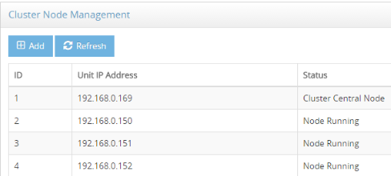
High Performance Software and Hardware Platform
  FastPacketModule is AppScaler proprietary Packet Module empowered by Intel DPDK, which is 10 times faster than regular Linux Kernel when it comes to packet processing.
  ASIC SSL Acceleration Card: 35K TPS (2K key)
  Active-Active clustering can aggregate multiple AppScaler virtual/hardware appliances as one single unit to scale up to 600Gbps layer 7 throughput

Slide 5
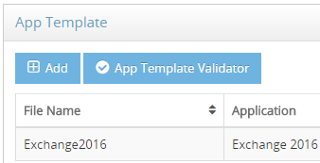
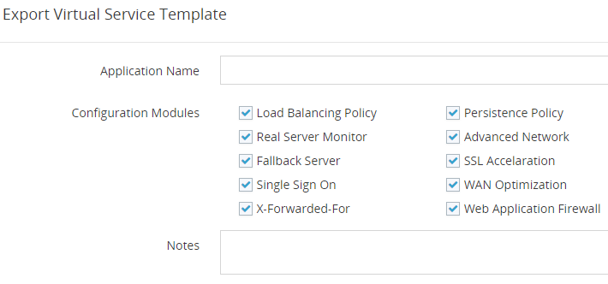
Simplicity with App Templates
  Load balancing is complicated by nature because of the complexity of business applications, no matter load balancing is managed with CLIs, scripts or GUI.
  AppScaler provides the configuration abstraction layer between business application and load balancer with App Template.
  XML format makes it easily import and export
  Ready-to-use AppTemplates like MS Exchange
  Build the load balancing in one click
  Flexibility of developing Custom AppTemplates for advanced users

Slide 6
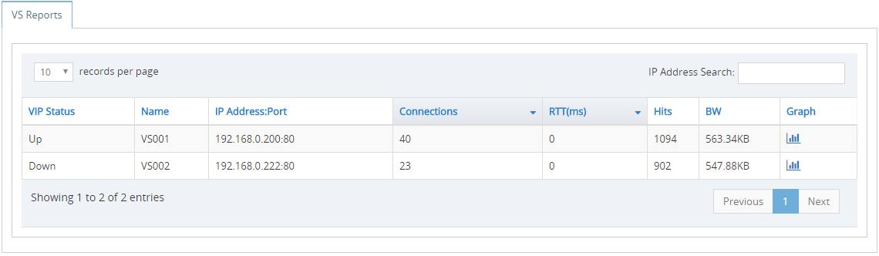
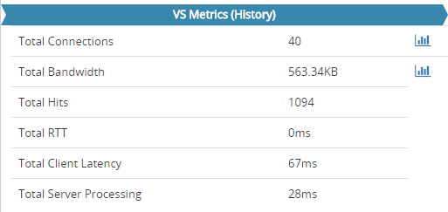
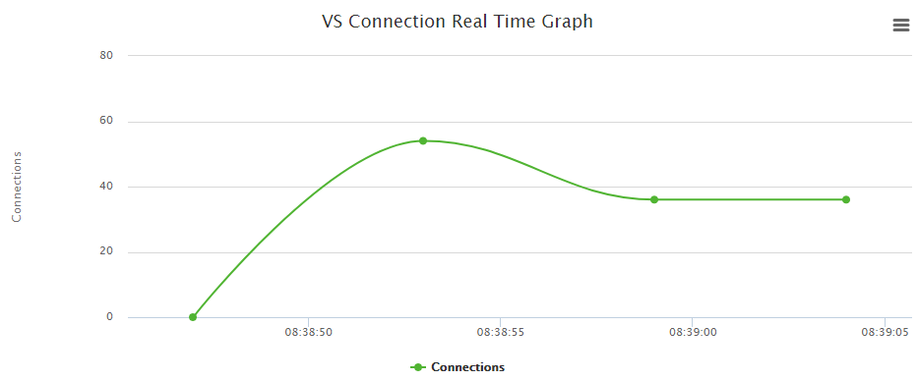
Application Visibility
  Application visibility is an critical component to monitor and diagnose the performance of the business applications.
  AppScaler gathers real time and historical statistics including connections, bandwidth, hits, application RTT (Round Trip Time), client latency and server processing latency to provide end-to-end visibility across all the business applications.

Slide 7


Multi Tenant Virtual Network Function
  Provision and manage AppScaler as Virtual Function centrally
  Multi-tenancy to improve operational efficiency and service agility as well as lowering total costs
  Support up to 64 isolated AppScaler instances on one single unit
SSL
Tenant 1
AppScaler
Virtual
Appliance
Tenant 2
AppScaler
Virtual
Appliance
Tenant 3
AppScaler
Virtual
Appliance
Tenant N
AppScaler
Virtual
Appliance
Client
Server
AppScaler Hypervisor Platform
High Performance AppScaler VNF Hardware
Web Console

Slide 8


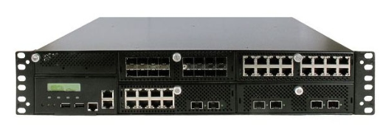
Dual IPv4 and IPv6 Stack
  Full support on Dual IPv4 and IPv6 Stack
  Automatic IPv4/IPv6 conversion makes IPv6 migration much easier
  Client(IPv4)->VS(IPv4)->RS(IPv4)
  Client(IPv6)->VS(IPv6)->RS(IPv6)
  Client(IPv4)->VS(IPv4)->RS(IPv6)
  Client(IPv6)->VS(IPv6)->RS(IPv4)
  Response rewrite to fix external links in IPv4 website
IPv4 and IPv6
Auto Conversion
Real Server
IPv4 or IPv6
Virtual Server
IPv4 or IPv6

Slide 9
Comprehensive Single Sign On (1)
  AppScaler provides centralized and flexible application access authentication to consolidate identity access management infrastructure and realize enhanced security at a reduced operational cost.
SSO
Application 1
Same SSO Ident
Application 2
Same SSO Ident
Integration
Auto login integration
with original
application login
Client
Server
AppScaler SSO Cache Proxy
3rd party identity infrastructure
LADP/Radius/Kerberos/RSA SecurID/NTLM/SAML
1FA/2FA/Basic Authentication/Token
Real time user login information
Custom Post Form
AppScaler SSO API
Custom Integration

Slide 10
Comprehensive Single Sign On (2)
  Typical SSO Workflow:
  User accessing the SSO enabled virtual service on AppScaler
  AppScaler launching Pre-authentication Login Form (Either 1FA or 2FA)
  User inputting the credential in Login Form
  AppScaler passing credential to be authenticated with 3rd identify system
  If authenticated, user can access this virtual service
  The same user with the same connection can access all the SSO enabled virtual services with the SAME SSO Profile in Access Policy

Slide 11
Comprehensive Single Sign On (3)
  Integration with applications for automatic login:
  All the applications have its own set of login mechanism
  AppScaler provides pre-authentication but without the integration with application the re-login of applications required.
  AppScaler provides 3 toolsets/services for integration purpose to achieve automatic login with applications
  AppScaler capturing credential in login form and post to the applications by custom and flexible POST form
  AppScaler providing SSO API for applications to retrieve the user login information
  AppScaler providing custom integration service with application on SSO

Slide 12
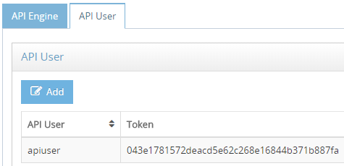
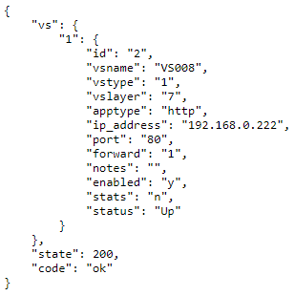
Open System with Full API
  AppScaler provides comprehensive APIs for automation and orchestration, which makes software development team stage, deploy and update business application quickly and safely without the concern of disrupting ongoing business processes.
  HTTP(s) based
  XML and Json support in runtime
  370+ APIs

Slide 13
All-in-One Application Delivery Solutions
  Turnkey Application Delivery Solution:
  Server Load Balancing
  Global Server Load Balancing
  SSL Offloading
  Single Sign On
  Web Application Firewall
  Hardware Security Module
  Active-Active Clustering

